Slide 1
MENTAL HEALTH
ASSESSMENT
PROJECT REPORT
Under The Guidance Of:
P. RAJA, MASTER TRAINER
Faculty:
Dr.V.C. SATHISHGANDHI, ASSISTANT PROFESSOR
BY:
JASMIN RIZWANA ATHIQAH J,
jasminjuhani26@gmail.com
NM ID-au810021114030

Slide 2
OUTLINE
Problem Statement
Proposed System/Solution
Methodology
GitHub Link
Project Demo(photos / videos)
Conclusion
Future Work
References

Slide 3
PROBLEM STATEMENT
This approach addresses the need for accurate and accessible mental health assessment tools, as mental health issues are often underdiagnosed due to subjective reporting, limited access to professionals, and societal stigma. By leveraging facial emotion recognition technology, this method aims to objectively identify signs of conditions like depression, anxiety, and stress through subtle facial cues.

Slide 4
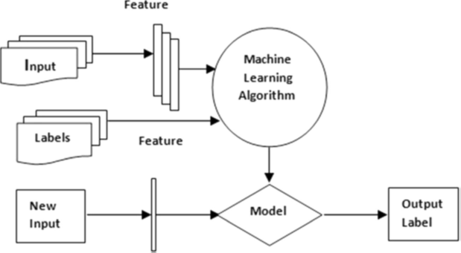
PROPOSED SOLUTION
The proposed solution combines facial emotion recognition (FER) with AI-driven analysis to create a non-intrusive, accessible tool for mental health assessment. By analyzing subtle facial expressions captured via video or smartphone cameras, the system can detect indicators of mental health conditions such as depression, anxiety, and stress. This data-driven approach offers objective insights into emotional states over time, enabling early detection and continuous monitoring without relying solely on self-reporting or in-person consultations. This tool could make mental health support more accessible, reduce stigma, and empower individuals and clinicians with actionable insights

Slide 5
METHODOLOGY
Start
Input image
Face Detection & Alignment
Facial Feature Extraction
Emotion Classification Model
Emotion & Expression Analysis (e.g., mood, stress)
Display/Store Results for Assessment
Continuous Monitoring & Alerts
END

Slide 6
GITHUB LINK
https://github.com/RIZWANA-4030/mental-health-assesment

Slide 7
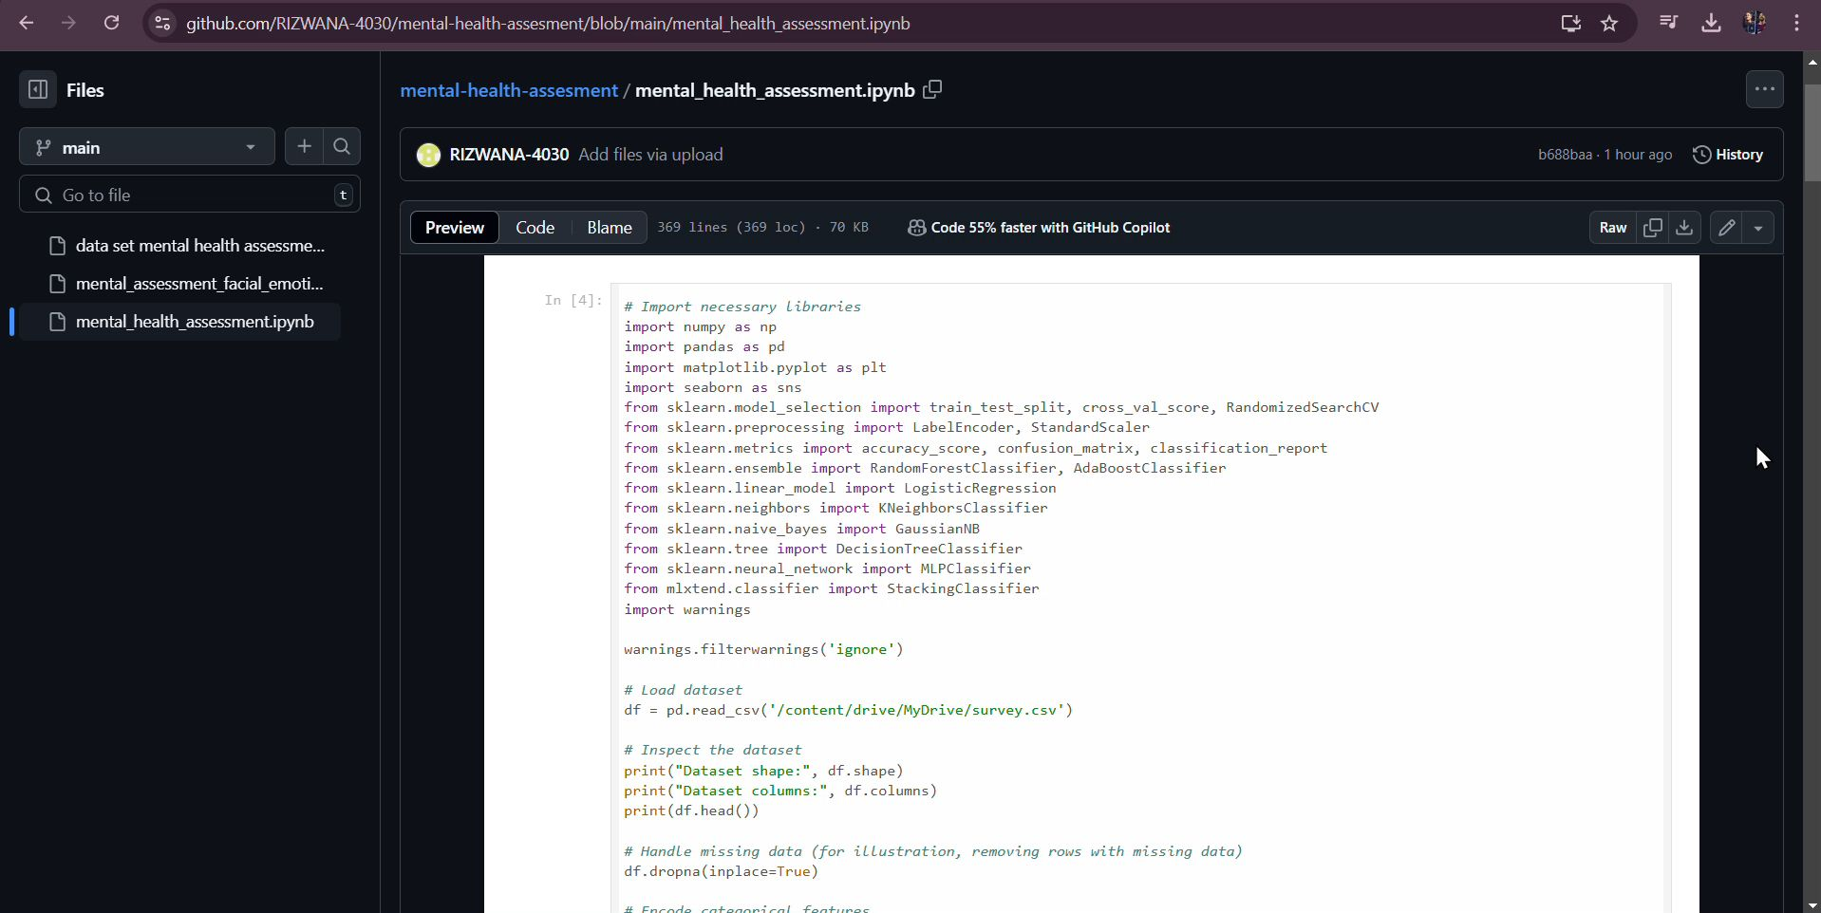
DEMO VIDEO

Slide 8
CONCLUSION
In conclusion, our mental health assessment model uses machine learning to identify potential mental health risks based on survey and demographic data. Through data preprocessing, feature selection, and model evaluation, it provides a tool to support healthcare professionals in identifying at-risk individuals. Although the model shows promise, it is designed as a supplement to clinical expertise. This project demonstrates AI’s potential in mental health support, emphasizing the importance of ethical considerations, data privacy, and clinical validation for safe and reliable real-world use.

Slide 9
FUTURE SCOPE
Focus on improving model accuracy with diverse datasets and integrating multimodal data, such as text, voice, and facial expression analysis, for a more comprehensive assessment. Advanced NLP and deep learning models could enhance the analysis of self-reported symptoms and detect subtle indicators in video or voice data. Ongoing clinical validation, ethical data practices, and bias mitigation will be essential. Additionally, future models could provide personalized recommendations, connecting users to tailored mental health resources and professional support.

Slide 10
REFERENCES
Fig 1 - A Brief Review of Facial Emotion Recognition Based on Visual Information Byoung Chul Ko
Fig 2 - Behavioral Modeling for Mental Health using Machine Learning Algorithms M. Srividya & S. Mohanavalli & N. Bhalaji.

Slide 11
THANK YOU

